Slide 1
Digital Portfolio
STUDENT NAME: V.Abinathan
REGISTER NO AND NMID: 212402320/asunm1301212402320
DEPARTMENT: BCA
COLLEGE: COLLEGE/ UNIVERSITY

Slide 2
PROJECT TITLE
Digital PORTFOLIO

Slide 3


AGENDA
Problem Statement
Project Overview
End Users
Tools and Technologies
Portfolio design and Layout
Features and Functionality
Results and Screenshots
Conclusion
Github Link
3/21/2024 Annual Review

Slide 4

PROBLEM STATEMENT
In today’s competitive digital landscape, professionals often struggle to showcase their skills, qualifications, and achievements in a visually engaging and accessible way. Traditional resumes lack interactivity and fail to reflect a candidate’s personality or creativity.
This portfolio website aims to solve that problem by providing a modern, responsive, and personalized online presence that highlights the individual’s bio-data, education, skills, and certifications. It enables recruiters, collaborators, or clients to quickly assess the individual’s capabilities through an elegant and professional user interface.

Slide 5

PROJECT OVERVIEW
This project involves designing and developing a personal portfolio website that serves as a comprehensive digital resume and showcase. The goal is to create a visually appealing and user-friendly platform that highlights key personal and professional information, such as bio data, educational background, skills, and certifications.
The website is built using HTML and CSS, featuring a responsive design that adapts seamlessly across devices, from desktops to mobile phones. It incorporates modern web design principles, including clean typography, intuitive navigation, and interactive elements like hover effects to enhance user engagement.
By using a fixed background image with an overlay container, the design balances aesthetics with readability. The portfolio aims to provide a professional yet approachable online presence that can help attract potential employers, clients, or collaborators.

Slide 6

WHO ARE THE END USERS?
The primary end users of this portfolio website include:
POTENTIAL EMPLOYERS AND RECRUITERS: Looking to quickly assess qualifications, skills, and certifications to determine suitability for job roles.
CLIENTS AND COLLABORATERS: Interested in evaluating expertise and previous achievements before engaging in projects or partnerships.
ACADEMIC INSTITUTIONS OR MENTORS: Reviewing educational background and accomplishments for scholarship or mentorship opportunities.
NETWORKING CONTACTS: Friends, colleagues, or industry professionals who want to learn more about the individual’s professional profile.
THE PORTFOLIO OWNER: Using the site as a personal digital showcase and tool to manage and present career information professionally.

Slide 7

TOOLS AND TECHNIQUES
Tools:
HTML5: To structure the content of the portfolio, including sections for bio data, education, skills, and certificates.
CSS3: For styling the webpage, including layout design, colors, typography, and responsive behavior.
Web Browser (e.g., Chrome, Firefox): To test and debug the website for cross-browser compatibility.
Image Editing Software (optional): Tools like Photoshop or Canva used to prepare profile pictures and certificates images.
Code Editor (e.g., VS Code, Sublime Text): For writing and organizing the code efficiently.
Techniques:
Responsive Design: Using CSS media queries and flexible layouts to ensure the website looks great on desktops, tablets, and mobile devices.
Flexbox: For aligning and distributing elements inside containers, especially for certificates layout.
Hover Effects: Adding interactivity and enhancing user experience by changing styles on mouse hover.
Background Overlay: Using a semi-transparent background container over a fixed background image to maintain readability.
Accessibility Best Practices: Adding meaningful alt text for images and ensuring semantic HTML tags are used for better accessibility and SEO.

Slide 8
POTFOLIO DESIGN AND LAYOUT
The portfolio features a clean, modern design with a dark semi-transparent container over a fixed background image for readability. Content is centered in a max-width container, with a circular profile photo at the top. Sections are clearly divided (Bio Data, Education, Skills, Certificates) with accent-colored headings.
Lists have subtle backgrounds and hover effects, while certificates display in a responsive flexbox grid with hover zoom. The layout is fully responsive, adapting smoothly to mobile devices for easy viewing on all screen sizes.
Responsiveness:
The layout adapts seamlessly to different screen sizes using media queries.
On smaller devices (below 600px), certificate images expand to full width, and font sizes adjust for readability.
The flexible container width ensures content remains accessible without horizontal scrolling.
8

Slide 9
FEATURES AND FUNCTIONALITY
Responsive Design: Works seamlessly across desktops, tablets, and smartphones.
Profile Showcase: Prominently displays a circular profile photo with styled borders and shadows.
Organized Sections: Clear sections for bio data, education, skills, and certificates.
Interactive Elements: Hover effects on list items and certificate images enhance user engagement.
Visual Appeal: Uses a fixed background image with a semi-transparent overlay for readability.
Easy Navigation: Clean layout with readable fonts and accent colors for headings.
Accessible Content: Semantic HTML structure with descriptive alt text for images.

Slide 10
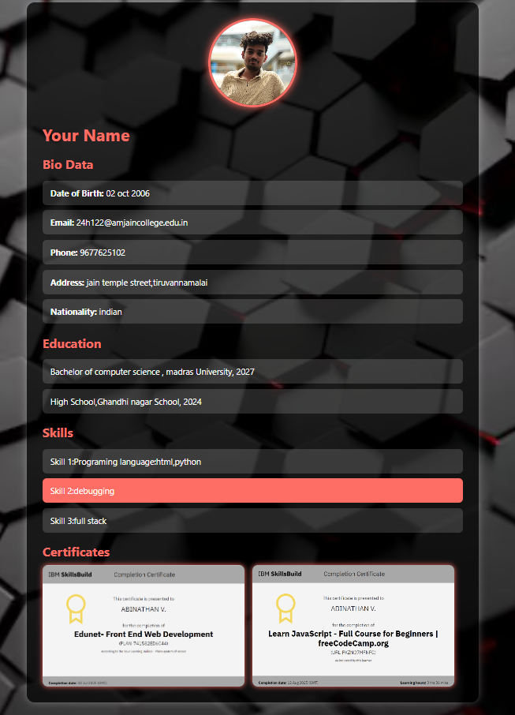

RESULTS AND SCREENSHOTS
3/21/2024 Annual Review
10

Slide 11
CONCLUSION
This portfolio website effectively presents personal and professional information in a visually appealing and user-friendly way. With its modern design, responsive layout, and interactive features, it offers an engaging experience for potential employers, clients, and collaborators. The site serves as a powerful digital tool to showcase skills, education, and achievements, helping to create a strong online presence and open up new opportunities.
11

Slide 12
GITHUB LINK
https://github.com/Abi-24H122/TNSDC-FWD-DIGITALPORTFOLIO-.git
Portfolio Link
https://github.com/Abi-24H122/TNSDC-FWD-DIGITALPORTFOLIO-/blob/7b5891782f6e22f431dd7221b9fd700abfa86f62/abi.html

